Slide 1

A Hot Bowl of Nomz
By: Conrad Tindall, Jairus Ang, and Bill Su

Slide 2
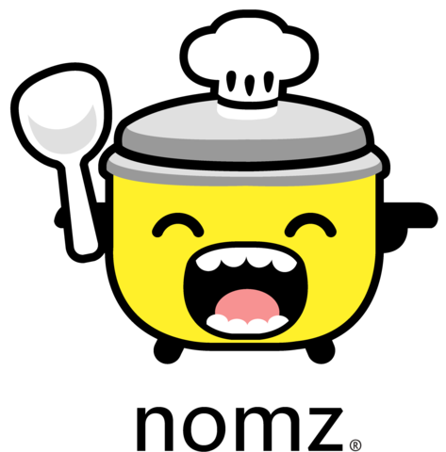
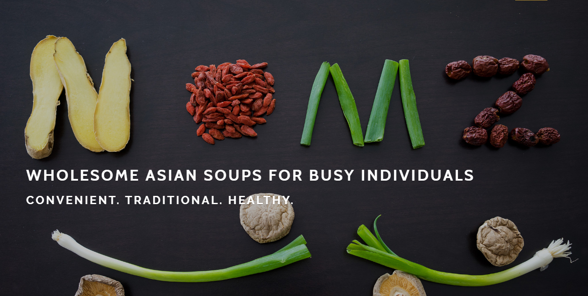
Talking Points for Today
Overview
Core Metrics
DUX
Search Analytics
Retrospect
Notes:
Break down the presentation

Slide 3
Nomz, Inc. - Client Overview
1
Convenient Wholesome Asian Soups in NYC’s Competitive Landscape

Slide 4
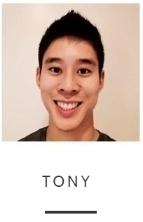
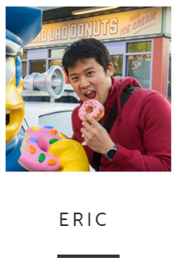
Client Background: A Young, Talented Team with a Novel Idea
Startup based in New York City
Started by Tony (McKinsey Consultant) and Eric (Controller at startup)
Started out selling only 1 product
Sold only about 15-20 soups a week, priced at $8 each
Notes:
Eatnomz is a …. Founded by …. Started out selling 1 … now 2 …. Soon 3
Low sales …
From Website:
A transplant from Northern California, Eric previously worked as the controller at a startup in the mobile advertising space. In his spare time, Eric likes to eat his way through New York and complain about the weather
A graduate of the Wharton School at the University of Pennsylvania, Tony previously worked in management consulting, private equity and international trade. He loves noups ("noodle soups"), Asian American data and hitting the game-winner in pick-up basketball (it never happens).

Slide 5
Unique Business Model Aims to Serve a Niche Market
Value proposition:
Provide convenient, traditional, and healthy Asian cuisine to busy individuals
Revenue Model:
Use website as main touch point for sales (Objective of the website) and deliver products to customers twice a week
Competitive Advantage:
Unique freeze and deliver model
Target Market:
Asian American, urban professionals in New York City between the ages of 20 and 34
Long term goal:
Enter into the frozen foods section of the grocery store market
Notes:
Provide healthy, tasty proucts to young professionals who dont have time to cook, but still want good food and stilll want to eat healthy
Uses website as its primary point of sale, uses shoppify platform
Produces and freezes soups in bulk
Delivers frozen soups twice a week, due to capaicity constraints
Uses a unique freeze and deliver busines model. Freezing prociess allows to preserve natural flavor and freshness
Target young asian americans working in nyc
Underserved market
Health conscious
Intimidated by foreign labels
Long term goal is to raise brand awareness to the poijnt where Tony able to enter into the frozen food section of gorcery stores
Allowing him to scale

Slide 6




High Competition in the Convenient and Frozen Food Spaces
Asian takeout and delivery
Saturated in big cities
Faster delivery than Nomz
Frozen, Asian cuisines
Competitors are established, national brands
Large presence in stores, as well as online
Products viewed as processed and unhealthy
Notes:
Nomz in intersection of two highly competitive enviornemtns
Indirect competitor with delivery, direct competitor with other frozen asian cuisine companies
Takeout saturaed in big cities by orderup and grubhub
Offer faster delivery
Frozen asian cuiines brands like ____ lareger, more brand awareness
Already have a laree presence in store and on line, through mediums such as amazon
However, opportunity because their products viewed as unhealthy with many preeservitives, where as nomz is healthy
The company has numerous competitors in the space. Asian
takeout is
abundant in big cities, and frozen Asian cuisine products a
lready exist in the
market (i.e. P.F. Changs.) However, as the company inte
nds to serve a very
niche market, many of the competitors could be considered i
ndirect
competition.
Brands like Yijo Foods and Annie Chun
’
s serve frozen Asian cuisines with an
organic all-natural focus, but mainly targets non-Asian Amer
icans. Other
options such as Asian take outs and commercialized brands
such as Wei-Chuan
serve cuisines that are highly processed and unhealthy as co
mpared to the
Nomz products.

Slide 7
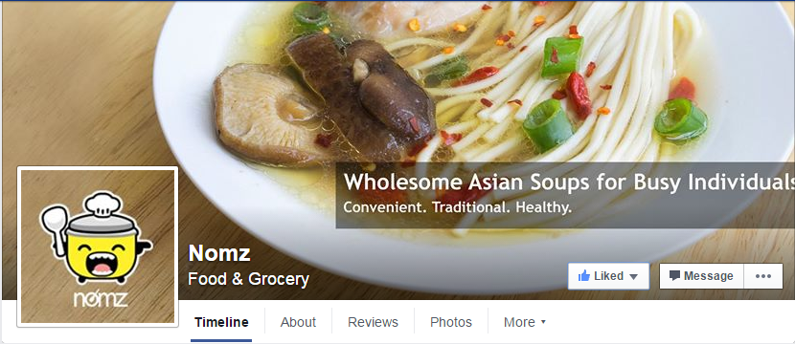
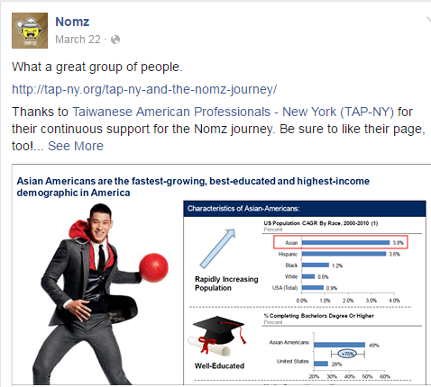
Nomz Needs to Expand Its Customer Base
Current Marketing
Facebook posts and outreach to founder networks
Occasional blog posts on Nomz website
Project Objectives
Improve DUX
Increase overall traction and revenue
Notes:
Due to startup nature, Current marketing efforts are limited
Leveraging personal network through facebook
Infrequent facebook activity/posts
FB reach only 314 people likes
Some engagement through blog posts, but low page visits
This is the main area they need help with
Sets up the goals for our engagement
Increase custoemr base, improving revenue and number of transactions online
While simultaneously improving brand awareness by leveraging digital medium
Monitoring
Changes to website
SEO
Search Ads

Slide 8
Many Challenges Face Both the Client and the Consultant
Client Obstacles
Small customer base
Limited network reach
Low brand awareness
Team Obstacles
Little influence in NYC market
Short-staffed team
Limited ability to make website design changes
Notes:
David vs Goliath story
From the client side, starting off with a small custoemr base
Relying primarily on personal connnections
Only two founders --=> their network can only reach so far before start imposing on their ability to expand
Low brand awareness serves as a hurdle for potential customers
Team facing many obstacles as well
Client located in nyc gave us limite ability to directly play a role in the nYC market
Work purely remote action
In early stages of the engagement, Team went from 5 to 3 peopls
Limited ability to make website design changes because of poor design of templates, and litle traffic to base decision change on
Only one AB test at a time

Slide 9
Web Analytics Metrics
2
Systematic analysis of web presence to identify opportunities.

Slide 10
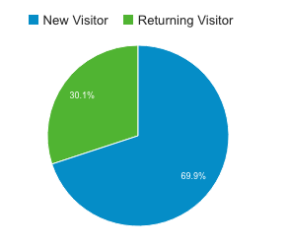
Baseline Performance Established at Beginning of Client Relationship
2,062 Sessions
3,094 Page Views
1:17 Avg. time on page
Revenue
$2,862 total revenue
111 purchases
Baseline Period:
Jan 1, 2016 - Feb 22, 2016
426 Users
388 New Users
111 Returning users
Bounce rate
69% Overall
67% Home page
Notes:
First thing we had to do is establish a baseline
Looking at the time period ___ before actively engageed with the client
Few thousand sessions, yeilding ~1.5 page views
Modest average time on page
Small user base
Good number fo new users
Significant portion of new users returned
Fairly high bounce rate in early days of the cmpany … overall and homepage not much better
Modest sales
Old stuff:
Acquisition / customer base growth
New Users, Returning Users
Engagement
Number of Sessions Per User, Time on Page, Bounce Rates, Conversion Rates
Revenue
Total Revenue, Revenue per User,
E-Commerce Conversion Rate, Number of Transactions Over Time, Average Order Value
Demographics
Geo-targeted Filter for NY County (Manhattan)
Ages primarily 25-34

Slide 11
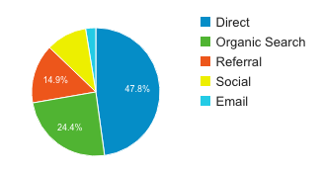
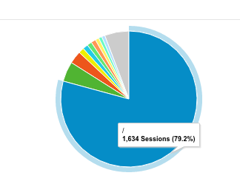
Custom Reports Indicate Need to Expand Customer Acquisition Strategy
Direct Traffic: 47.82% of sessions
Organic Search: 24.44% of sessions
79.79% of the site entrances are through the home page
Reflects need to increase marketing efforts
Source
Landing Page
Search Analytics is essential to promote nomz and boost sales
Notes:
Majority of people come to home page
Home page come to play a large role / subject of discusson
When we dove deeper and analyzed data, found that most traffic was direct, and little through search
Few new people actually searchign for his site
Huge opportunity → need to increase marketing efforts and drive search for nomz
Leading us to the conclusion that seach analytics is gong to be key iin boosting nomz sales and awareness

Slide 12
Digital User Experience (DUX)
3
Improving Digital User Experience Through Analytics

Slide 13
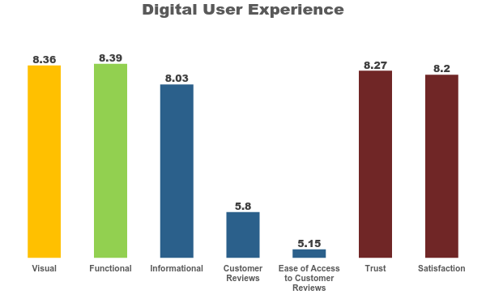
DUX Improvement
Website only received 140 visitors/week on average
Employed friends and Amazon Mechanical Turk
Visual and Functional rated highly
Improve Informational
Ease of access to customer reviews

Slide 14
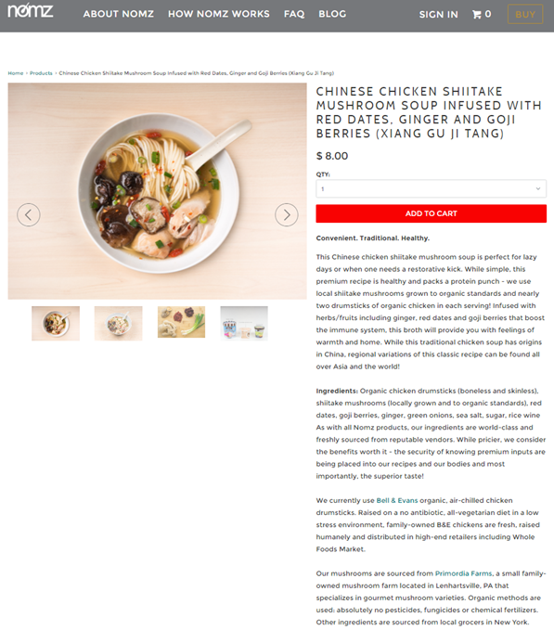
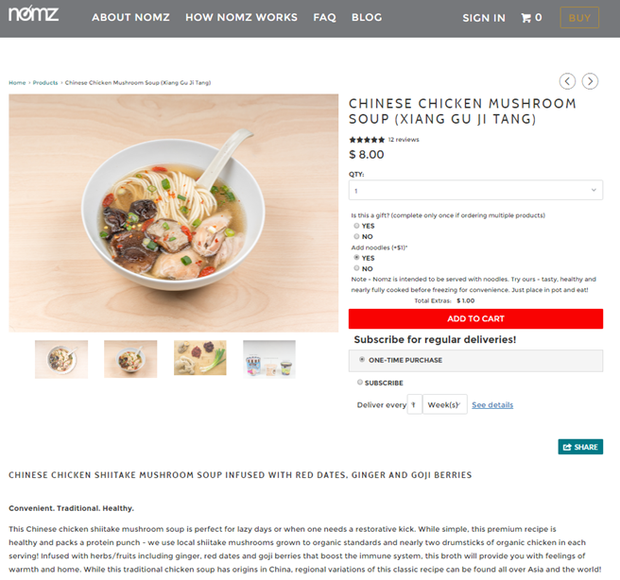
DUX Improvement - Informational Design
Before
After

Slide 15
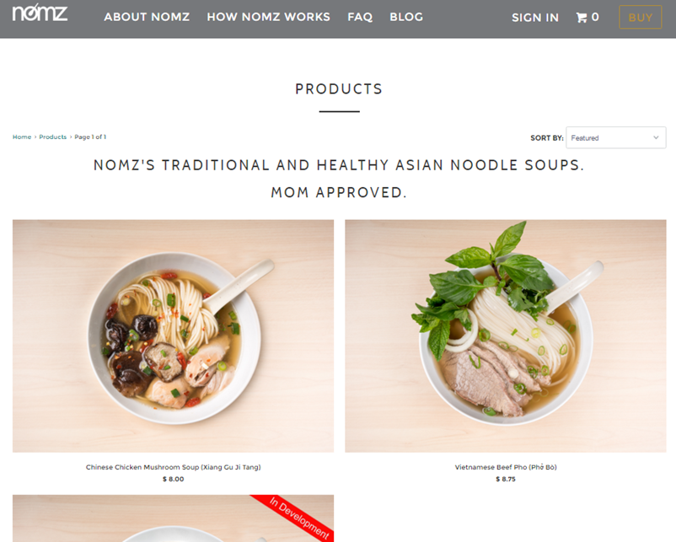
DUX Improvement - Collections Page Engagement
72.2% of traffic to the Shopping Cart Page
21.48% circled back to Home Page
15.5% Exit Rate (second to Home Page)
Notes:
The flow visualization also reveals that of the 176 that ended up in the shopping cart page, 128 went through the “Buy Button” page. This shows the importance of the “Buy Button” page in driving traffic to the shopping cart page (do not direct to add to cart directly, instead of directing user straight to shopping cart page when clicking on “Add to Cart”, allow a “continue shopping feature” and show a prominent update of shopping cart content.).
Additionally, the flow visualization shows that 55 session circle back to the homepage from the “Buy Button” page. This is interesting and might indicate that users prefer to find out more information about the business or the company from the homepage instead of continuing to find out more about individual products.
Finally, the “Buy Button” page has the highest number of dropoffs (15.5% of total traffic) from the website as compared to other pages (except homepage) within the funnel. We could look into ways to lower the number of dropoffs from the funnel at this page (insight - provide more information on this page such as overall reviews etc.).

Slide 16
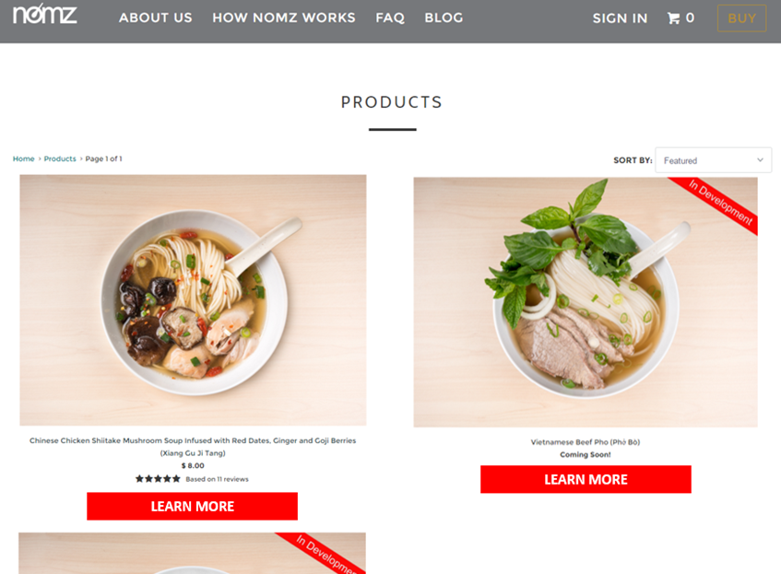
DUX Improvement - Collections Page Engagement
B Test
Ratings overview
Call-to-action button
50% lift in user engagement
Notes:
The flow visualization also reveals that of the 176 that ended up in the shopping cart page, 128 went through the “Buy Button” page. This shows the importance of the “Buy Button” page in driving traffic to the shopping cart page (do not direct to add to cart directly, instead of directing user straight to shopping cart page when clicking on “Add to Cart”, allow a “continue shopping feature” and show a prominent update of shopping cart content.).
Additionally, the flow visualization shows that 55 session circle back to the homepage from the “Buy Button” page. This is interesting and might indicate that users prefer to find out more information about the business or the company from the homepage instead of continuing to find out more about individual products.
Finally, the “Buy Button” page has the highest number of dropoffs (15.5% of total traffic) from the website as compared to other pages (except homepage) within the funnel. We could look into ways to lower the number of dropoffs from the funnel at this page (insight - provide more information on this page such as overall reviews etc.).

Slide 17
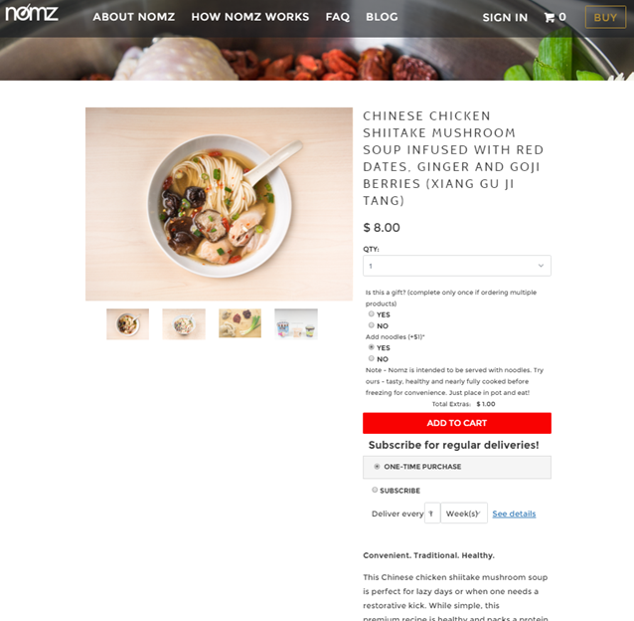
DUX Improvement - Home Page Engagement
Confusing design
Survey results revealed it was difficult to find relevant information on Home Page
Already has relatively low bounce rate (36.78%)
But Low Landing Page Experience on Adwords
Notes:
Peyton, Jay. "What's the Average Bounce Rate for a Website?" Good, Bad, Ugly, and Average Bounce Rates. Rocket Fuel, 25 Feb. 2014. Web. 24 Apr. 2016.

Slide 18
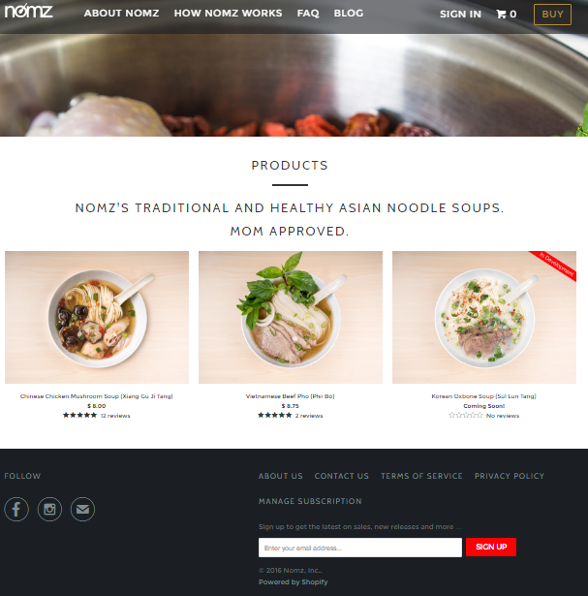
DUX Improvement - Home Page Engagement
Shortened home page
Ratings overview
No changes in Landing Page Experience
Need more data to attribute Bounce Rate changes
Notes:
44.29% (april 11 - 17) to 34.75% (april 18 - 24)

Slide 19
DUX Improvement - Major Results
9.5% decrease in Home Page Bounce Rate
16.7% decrease in Collections Page Bounce Rate
4.5% increase in Pages/Session
No changes in Landing Page Experience
Need more data to correctly attribute changes
Notes:
(april 11 - 17) VS (april 18 - 24)
Home Page Bounce Rate 44.29% to 34.75%
Colections page: 66.67% to 50%

Slide 20
DUX Improvement – Future Reccomendations
Switch to Wordpress
Send e-mails to existing customers to write product reviews
Notes:
(april 11 - 17) VS (april 18 - 24)
Home Page Bounce Rate 44.29% to 34.75%
Colections page: 66.67% to 50%

Slide 21
Search Analytics
4
Identifying opportunities and challenges to improve Nomz through search

Slide 22
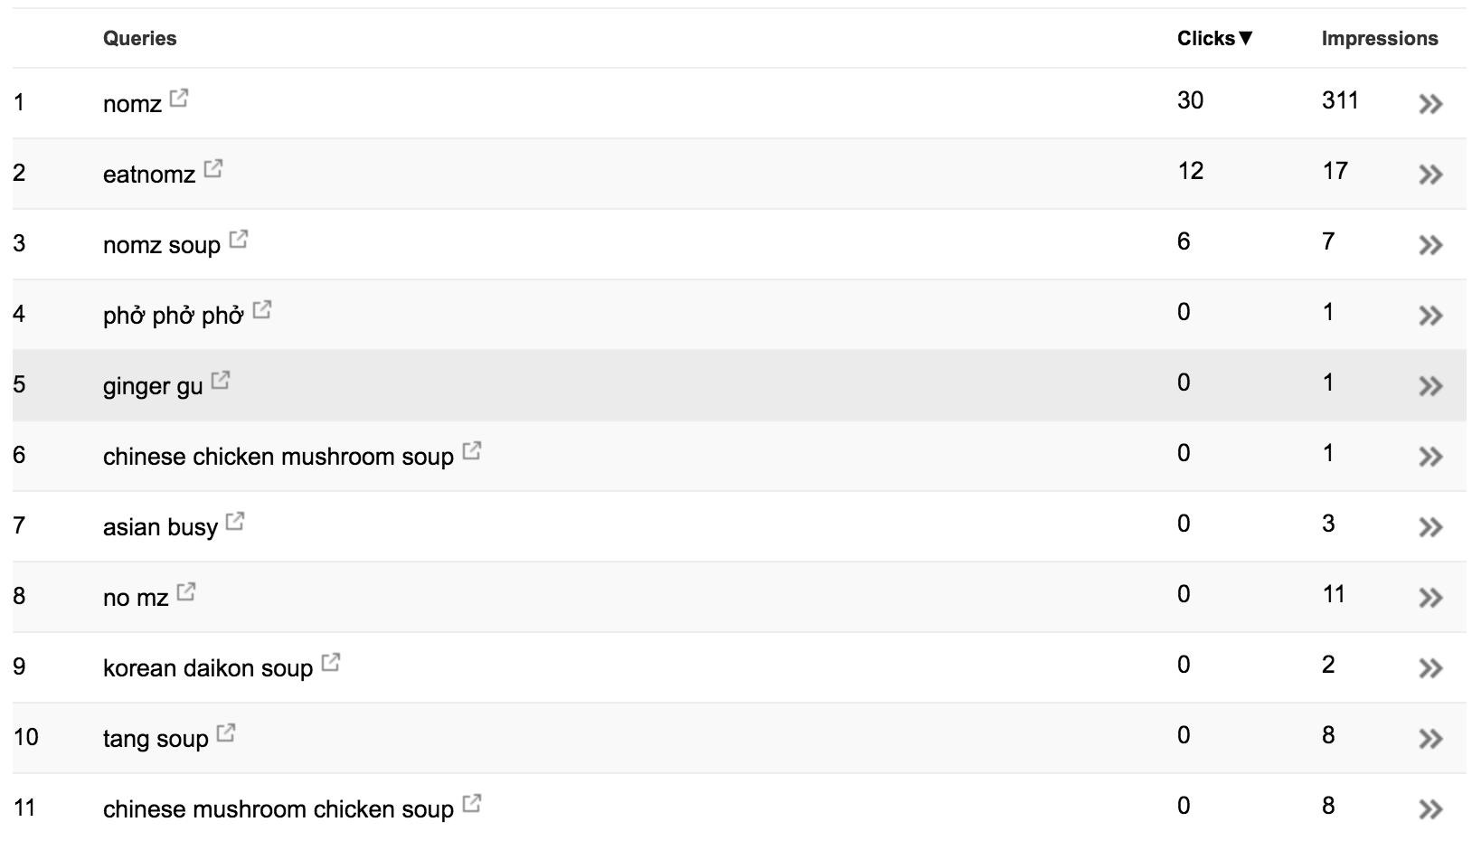
Search Analytics Status Quo
Undescriptive Keywords
Lack of Relevant Keywords
Overall Low Search Presence
Nomz Inc. struggles to obtain significant search traffics

Slide 23
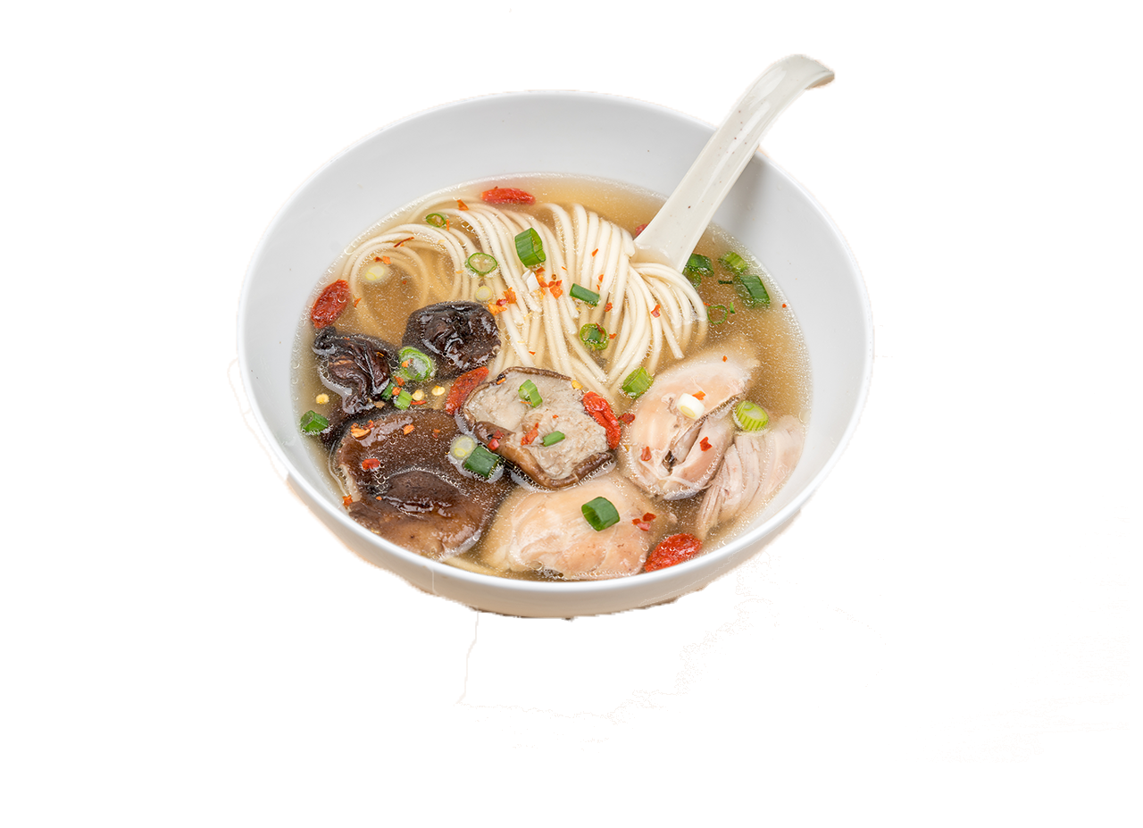
Search Improvement Objectives
Prompt more clicks from existing users through Search Engine Optimization.
Promote Nomz to get more new users through GOMC.

Slide 24
Search Engine Optimization
4.1
Analyzing keyword weaknesses and Improving search traffics

Slide 25
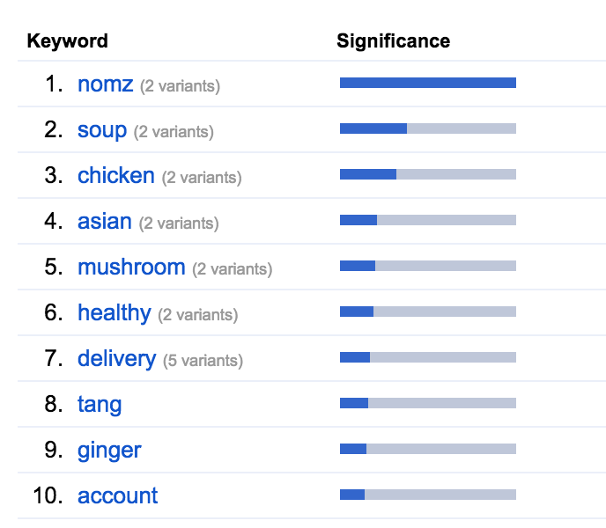
SEO Improvements
Stuff All Pages with Relevant Keywords such as “Healthy”, “Asian”, “Delivery” and “Soup”.
Dilution of general keywords such as “Wholesome”.

Slide 26
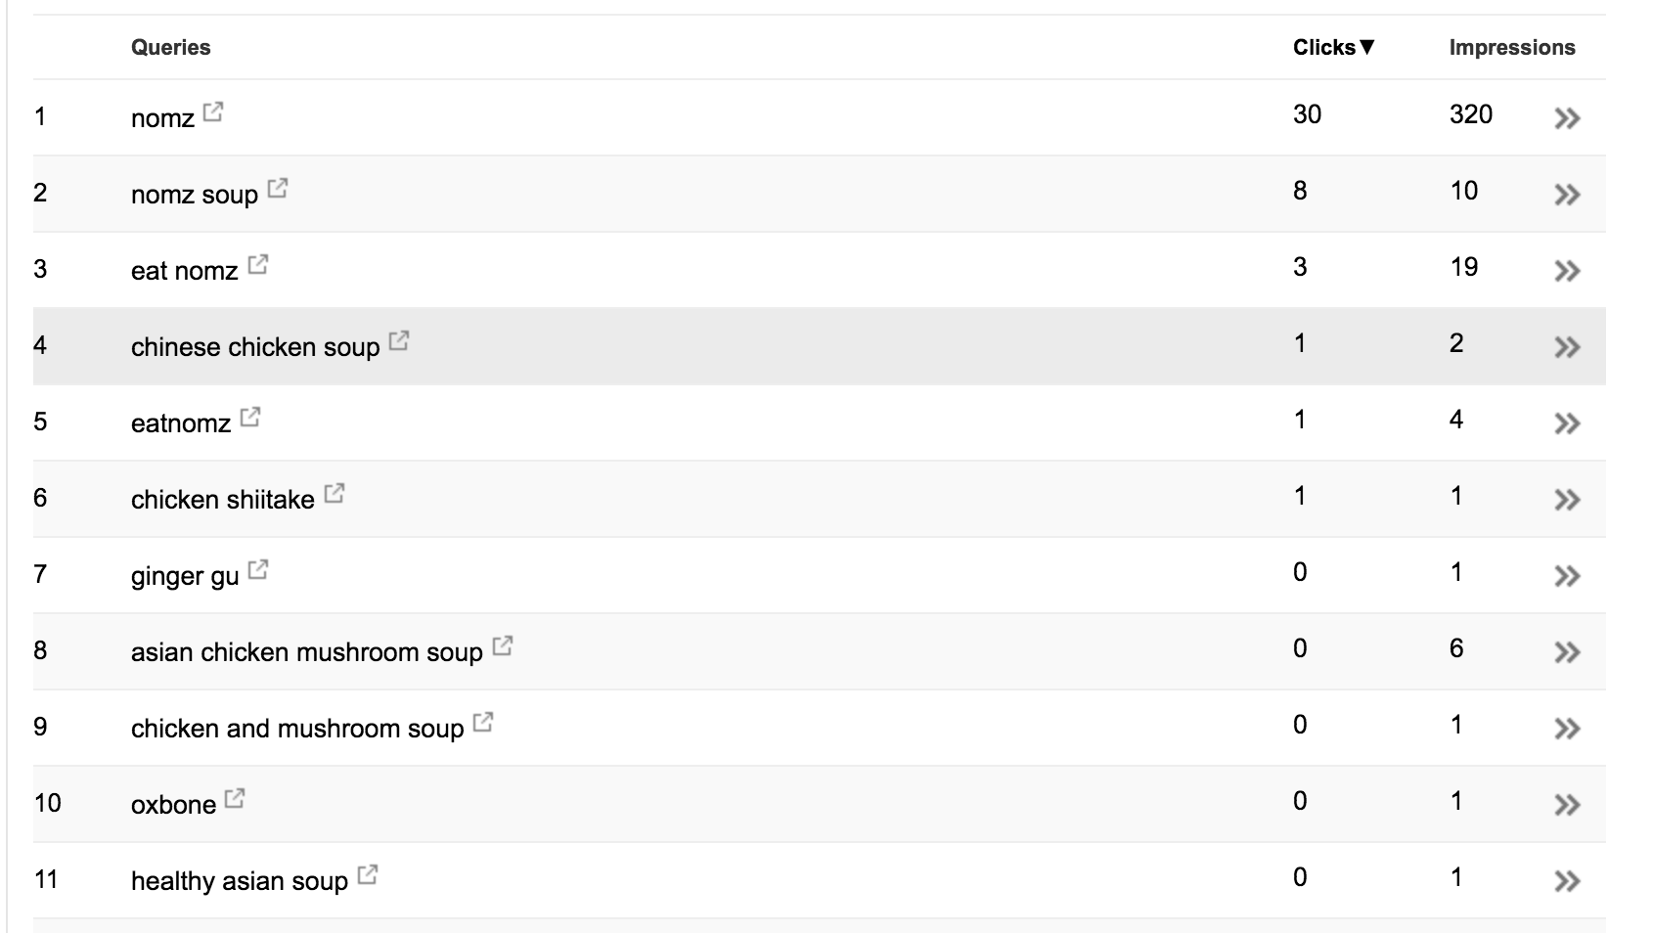
SEO Results

Slide 27
Google Online Marketing Challenge
4.2
Drawing traction through a systematic digital campaign

Slide 28
In our AdWords Campaign, we must generate impressions first before generating clicks.

Slide 29
AdWords Strategy Overview
Marketing-Based Campaigns (50%)
Exploration Campaigns (50%)
Branding (50%)
Function (10%)
Delivery (10%)
Product (20%)
Benefit (10%)
3 ad groups, "Nomz" related Keywords
6 ad groups, emphasize functions of the product (frozen, instant, easy)
16 ad groups, emphasize on the delivery aspect of the brand
10 ad groups, displayed various product offering of the brand.
8 ad group, emphasize on the benefits of the products (healthy, authentic, etc.)

Slide 30
Click-drawing Promotions
10% Discount
a coupon code for 10% discount for search only. The goal of this promotion is to increase CTR for the Ad Groups in the exploration campaign.
Nomz Raffle
A raffle in which up to 5 people can win 10 soups for themselves and two of their friends. The goal of this promotion is to work with other marketing efforts to draw clicks for the marketing-based campaign.

Slide 31
Three-Pronged Marketing Strategy
Facebook Campaign
Personal Outreach
Press Publicity
Each of these three approaches are designed to funnel impressions and clicks into the GOMC campaign.

Slide 32




Press Publicity
Compiled a list of 10 major Asian Blogs and Online Magazines.
Press releases throughout the second and third week.
April 11th
April 18th
(Instagram)
(Blog Post)

Slide 33
Facebook Campaign
Publicity tool to enhance effectiveness of other channels.
Further garner clicks through brand publicity
Increase Nomz’s social media presence
$400 Total Budget
Brand Campaign ($50)
Nomz Raffle Promotion ($200)
Press Release Promotion ($150)

Slide 34
Personal Outreach
Tony's New York Connections
Team's Personal Connections
Organizations In New York
AsAm Influencers
Personal Connections in NY
UVA Career Network
UVA Student Organizations
Personal Connections in New York
University Organizations
Professional Organizations
Ethnic Organizations

Slide 35
AdWords Marketing Schedule
Beginning of personal outreaches
Beginning of press releases.
Initiation of Facebook Raffle Campaign.
Initiation of Facebook Brand and Publicity Campaign
Release of Coupon
Release of Raffle
Week 1
Week 2
Week 3
Experimentation Phase
Raffle Phase
Publicity Phase

Slide 36
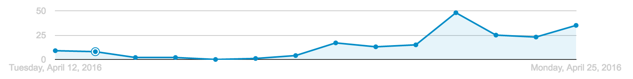
AdWords Outcomes (First two weeks)
Release of the Raffle, along with Facebook promotion, generated on average 10-15 additional clicks per day.
Starting of the press releases, along with personal outreaches, generated additional 10 clicks per day.
10% coupon and exploration campaign generated very little clicks throughout the first week, illustrating the competitiveness of the NY search market.

Slide 37
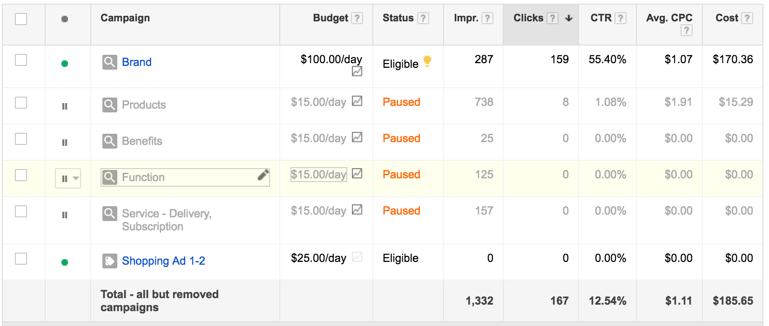
AdWords Observations
Brand Campaign created majority of the clicks (over 90%)
Exploration Campaigns received large amount impression but has very few clicks (8 clicks)

Slide 38
1,306 impressions
202 clicks
10% of Revenue Generated
11.17% click through rate
$88 Direct Revenue Generated
$1.05 cost per click

Slide 39
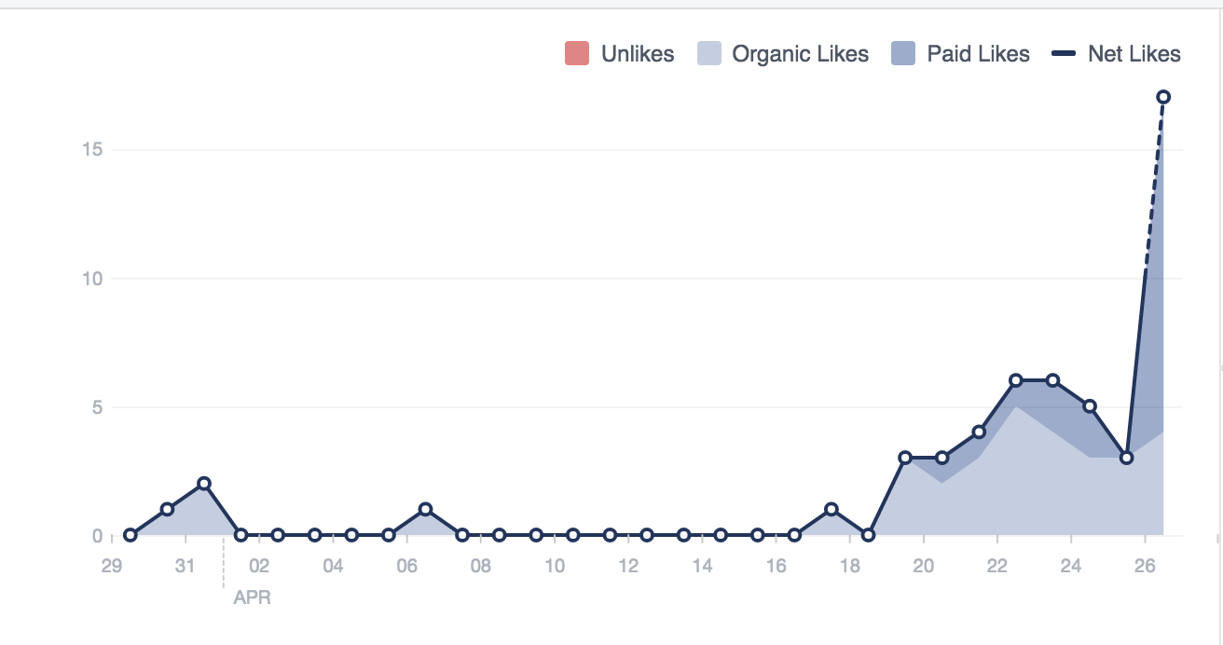
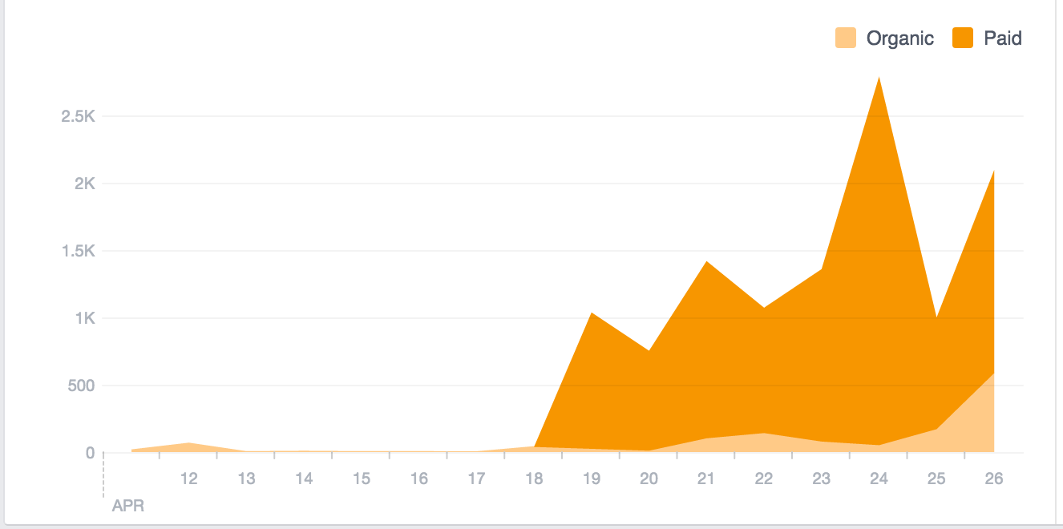
Other Outcomes: Facebook
289 Likes
337 Likes
10000+ Post Reach

Slide 40
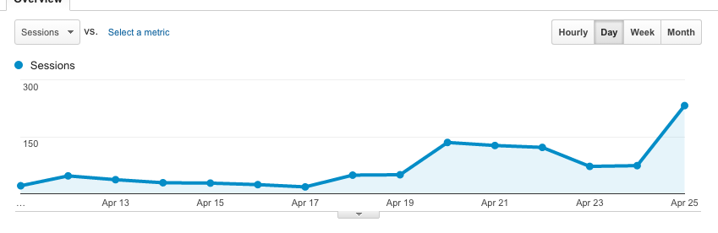
Other Outcomes: Web Metrics
220 new users
751 new users
351 sessions
1152 sessions

Slide 41
Conclusion
5
Retrospection and Future Improvement Recommendations

Slide 42
Lessons Learned
Don’t Bid on Competitive Keywords
The entire exploration campaign category generated over half of our impressions while producing only 8 clicks. We should’ve paused that group earlier.
Test Rapidly and Fail Quickly
Coupon did not work at all during the first week. We should’ve started the raffle as soon as we realized that Coupons are not working.
Plan Ahead for Uncertainties
Press releases were released much later than we have originally planned. We should’ve started contacting presses earlier.

Slide 43
Nomz Long-Term Improvements
Find a New Webhost
Shopify, as a website hosting platform, is extremely inflexible and does not offer plug-ins for SEO. We recommend Nomz to design the front end with Wordpress and use the Shopify Plug-in.
Engage with Users on Social Media
During this campaign we reactivated Nomz’s Facebook page and attracted many active viewers. Nomz should keep these users engaged by posting at least 2 posts a week.
Hire a Dedicated Marketing Person
All of Nomz’s online and offline marketing presences are undermanaged and has great potential. Tony should consider hiring a dedicated marketing manager to take advantage of this potential.

Slide 44
Thanks!
Any questions ?

Slide 45
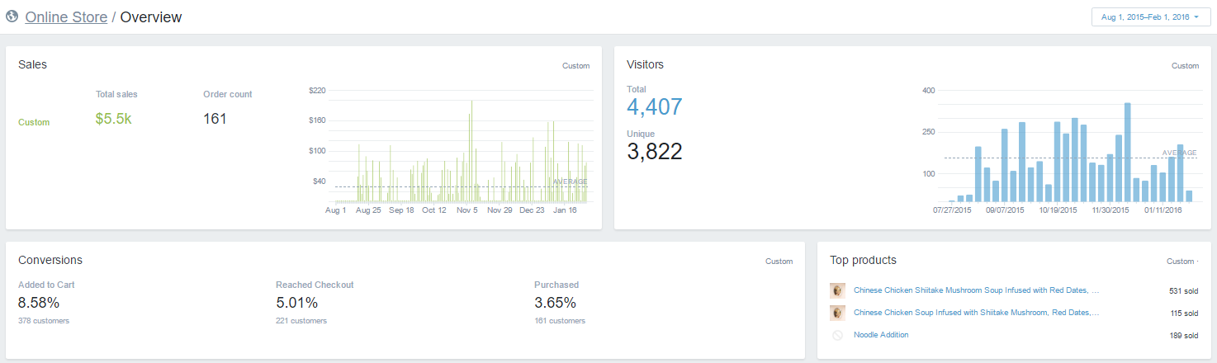
APPENDIX 1 - Client Overview Before Project

Slide 46
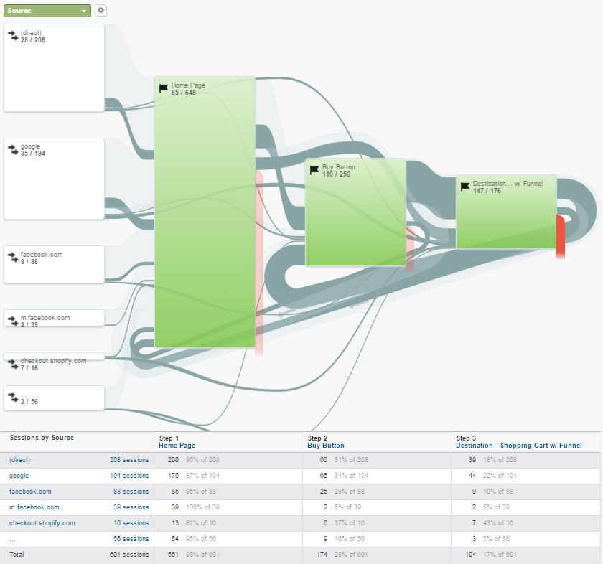
APPENDIX 2- Collections Page Engagement

Slide 47
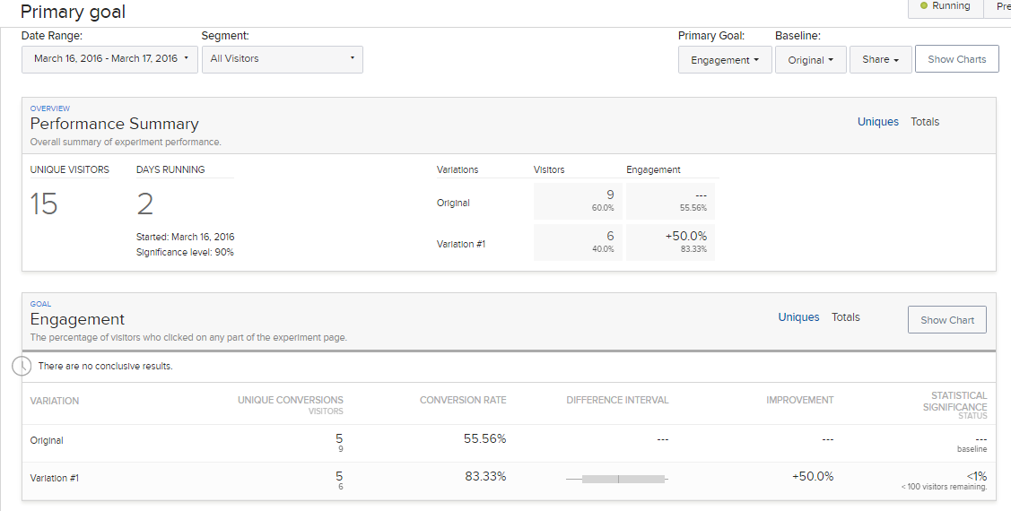
APPENDIX 3 - Collections Page A/B Test Results

Slide 48
APPENDIX 4 – Ad Groups
Brand | Benefits | Function | Products | Service
Eat Nomz EatNomz Nomz | Authentic Asian Authentic Chinese Healthy Asian Healthy Chinese Homemade Asian Homemade Chinese Traditional Asian Traditional Chinese | Easy Soup Frozen Asian Soup Frozen Chinese Frozen Soup Instant Soup Quick Soup | Asian Soup Chinese Mushroom Soup Chinese Noodle Soup Chinese Soup Easy Beef Pho Frozen Chicken Mushroom Soup Frozen Pho Instant Chicken Soup Noodle Soup Vietnamese Beef Pho | Asian Dinner Service Asian Dinner Subscription Asian Food Service Asian Food Subscription Asian Lunch Service Asian Lunch Subscription Asian Meal Service Asian Meal Subscription Chinese Dinner Service Chinese Food Service Chinese Lunch Service Chinese Meal Service

Slide 49
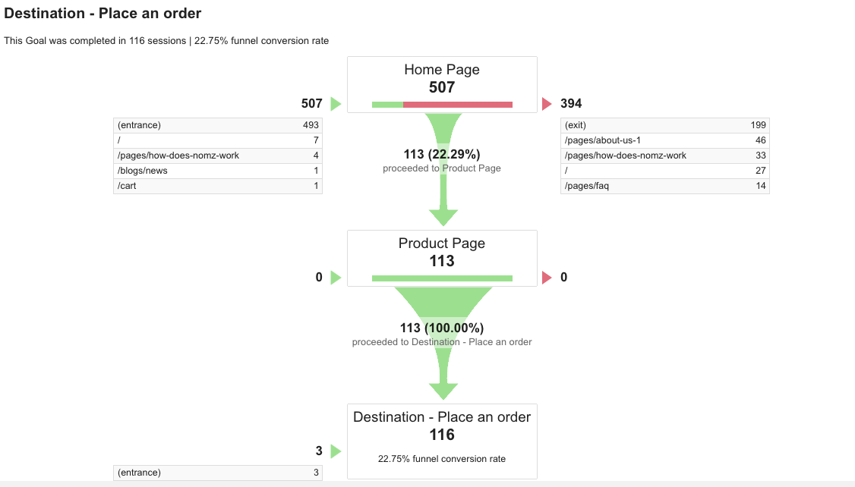
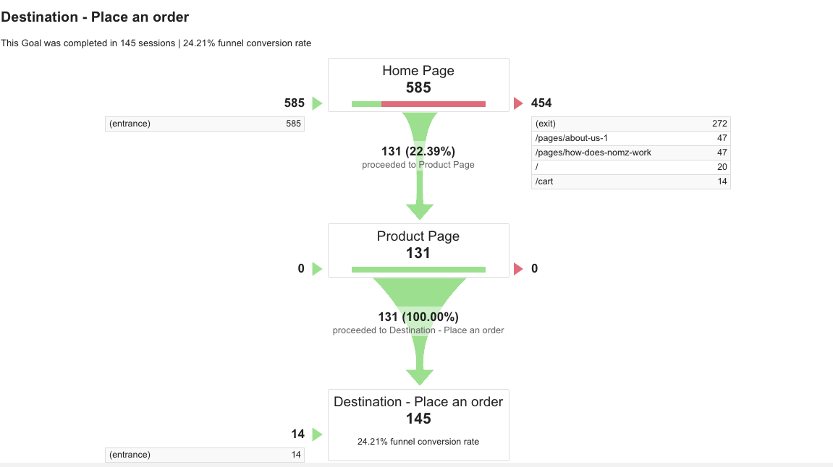
APPENDIX 5 – Conversion Funnels
March 1 – March 15
March 16 – March 31

Slide 50
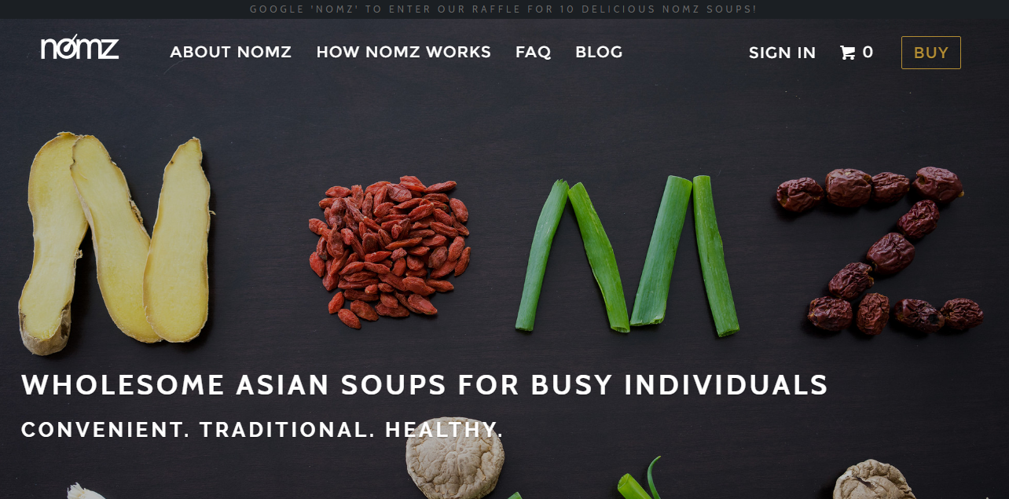
APPENDIX 6 – Promotional Banner for Raffle

